Slide 1



V
Apr 10, 2025
My Weekly
Updates
Song-Ze, Yu

Slide 2
VTR System Workflow
1. Dataset making
2. Extract features (e.g., spectral centroid, MFCC): model input
3. Attach label (EQ and compressor parameter): model output and ground truth
4. Model training / inference: regression/SVM and classification first, NN if available
5. Evaluate tone recognition performance
6. Write the JUCE interface if available

Slide 3
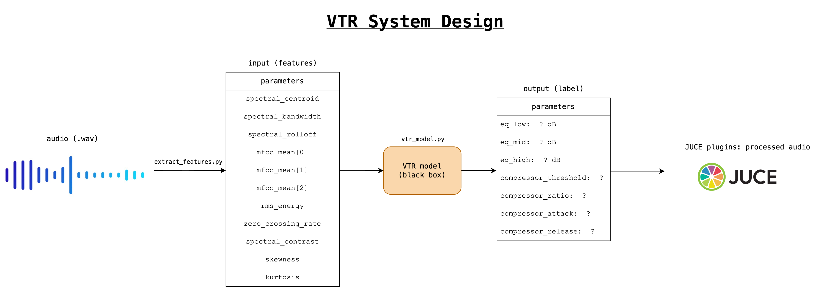

Slide 4
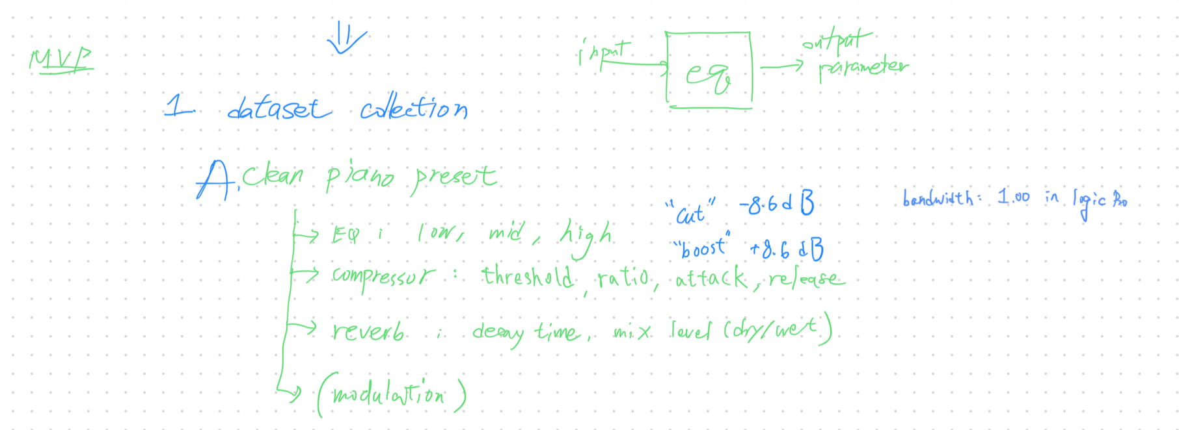
MVP Architecture
Create my own dataset
Goal: 500 samples

Slide 5
Progress: Dataset generating

Slide 6
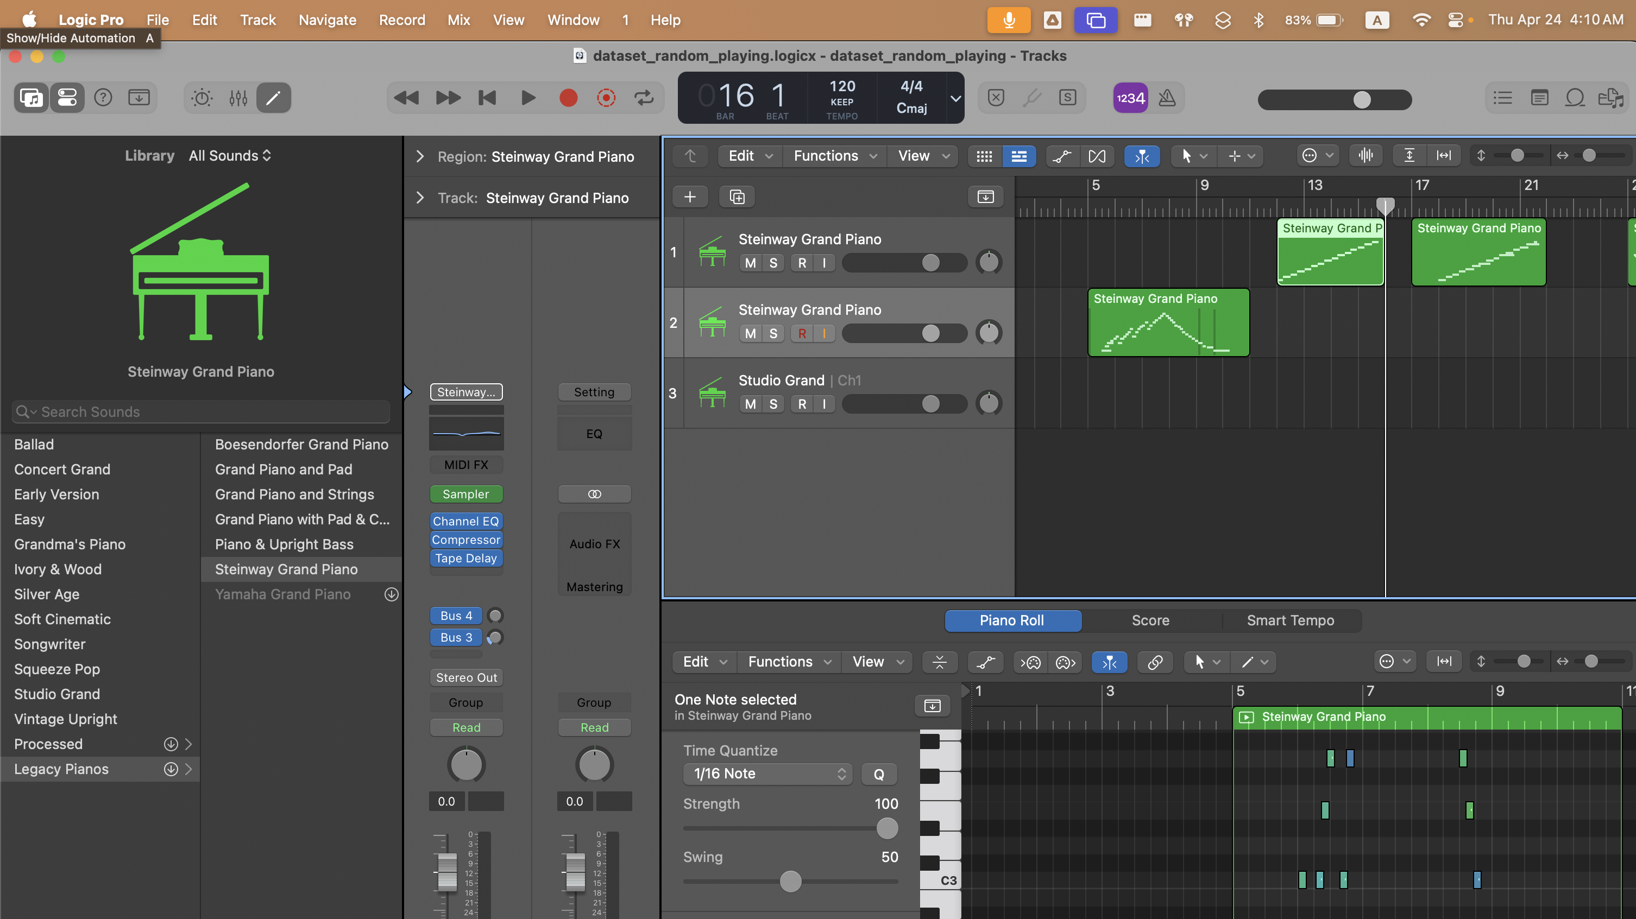
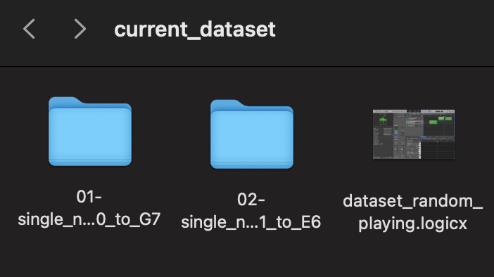
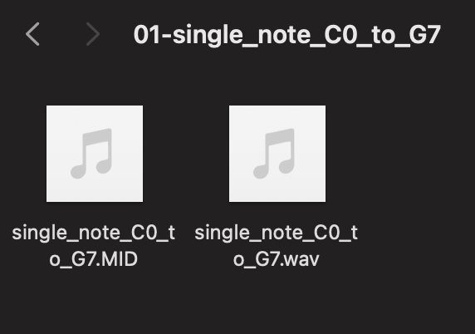

Slide 7
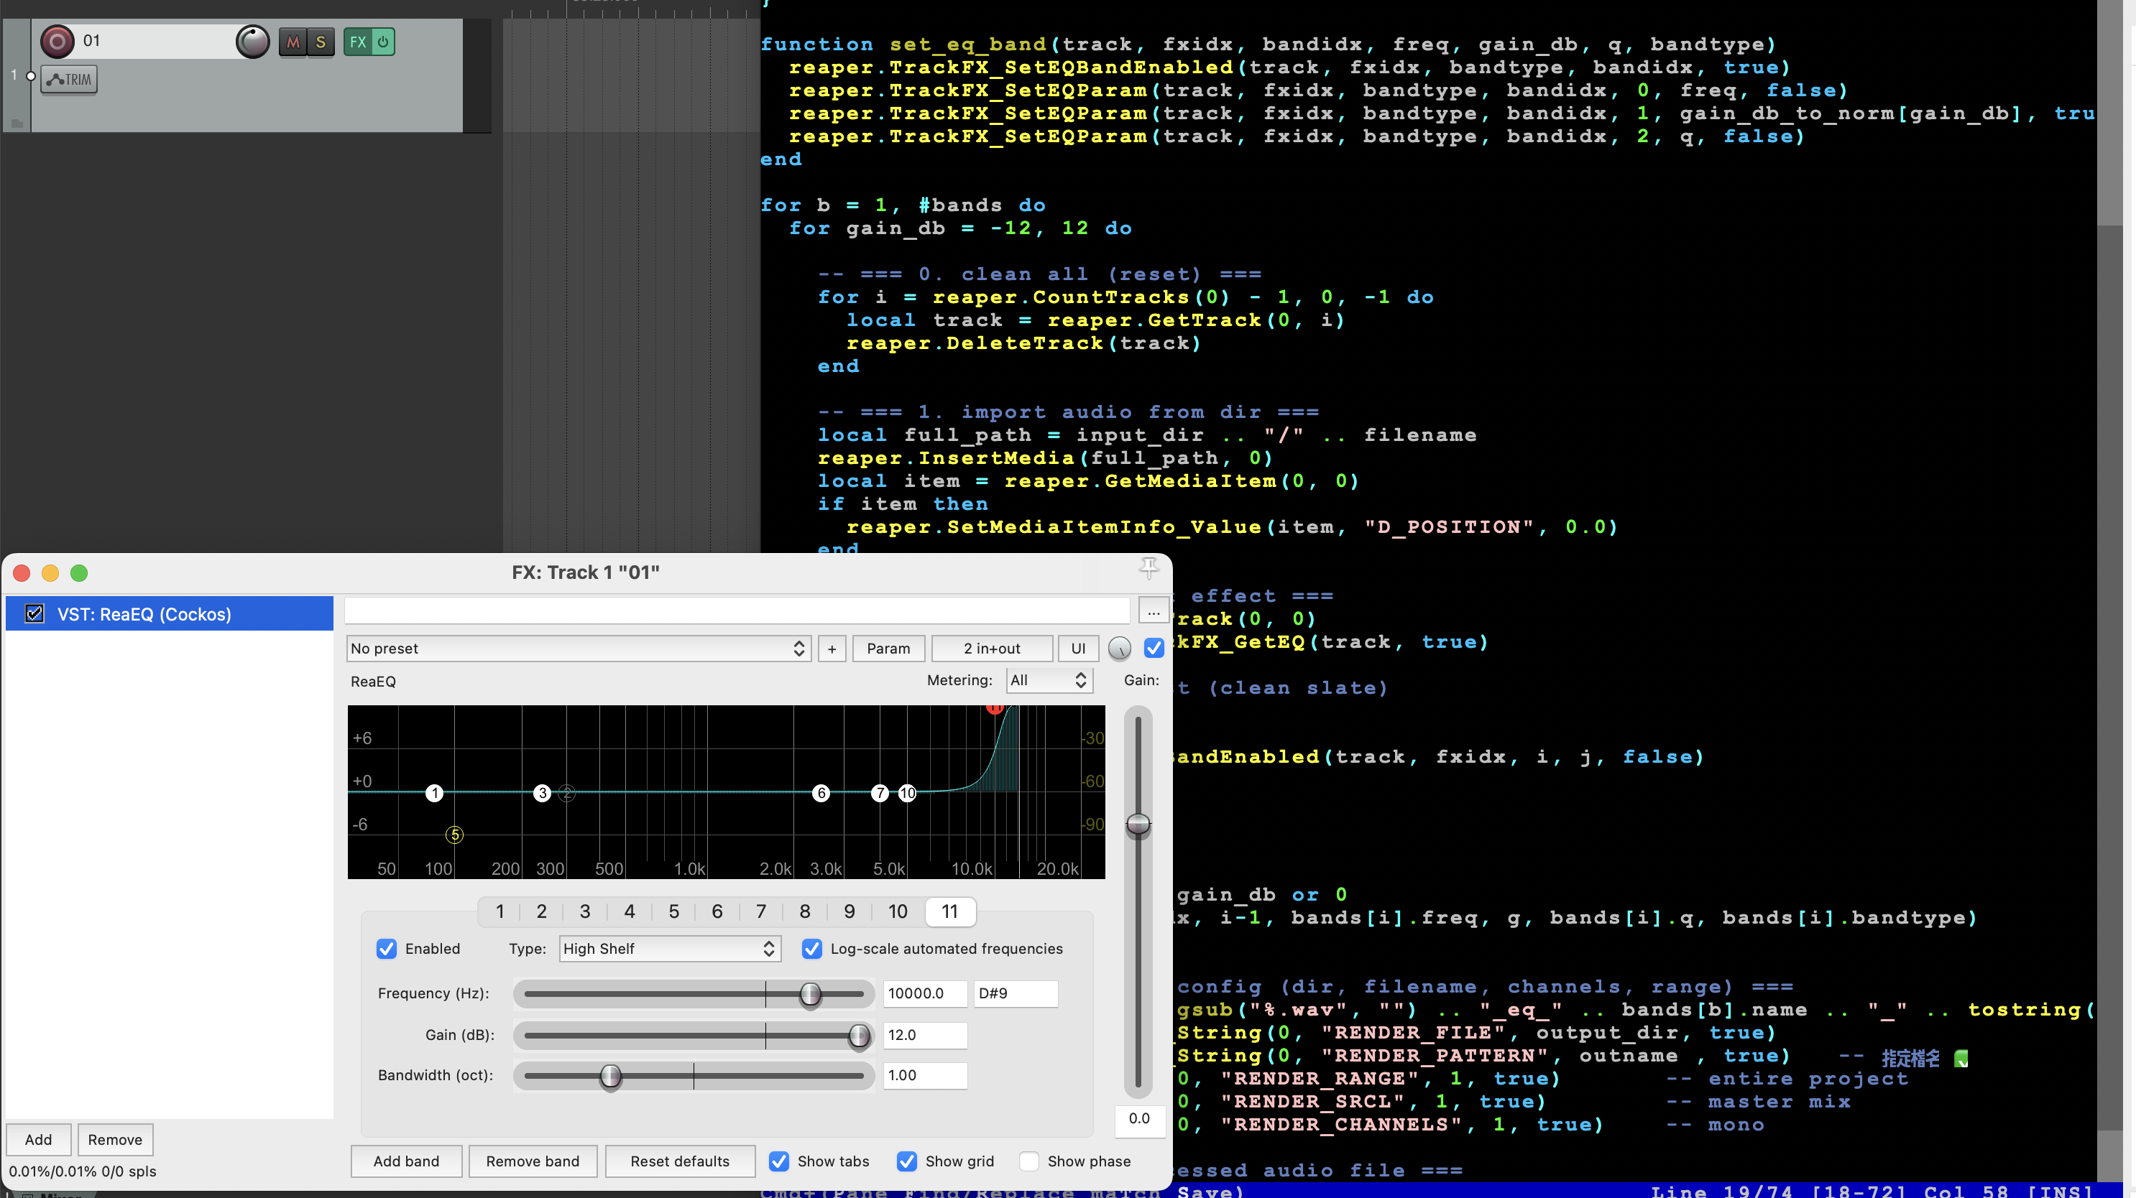

Slide 8
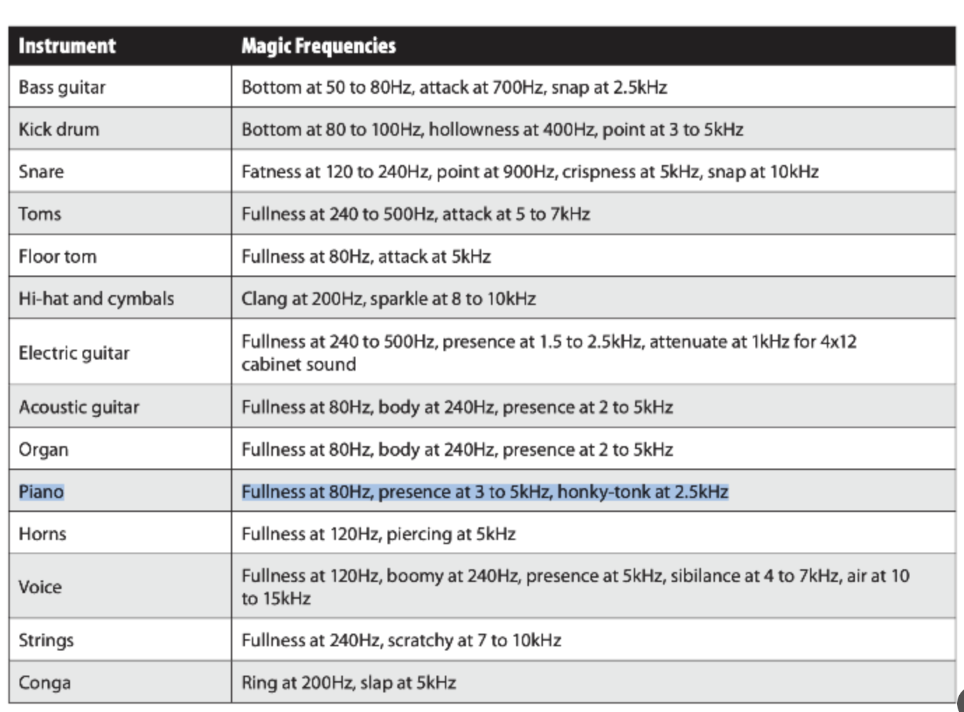
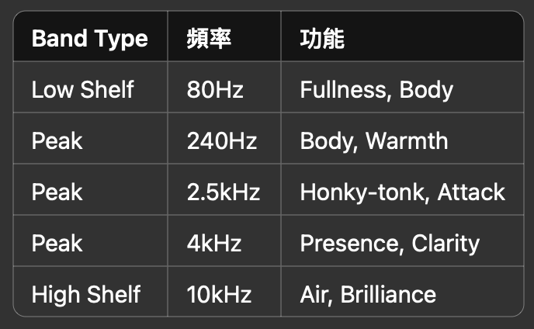

Slide 9
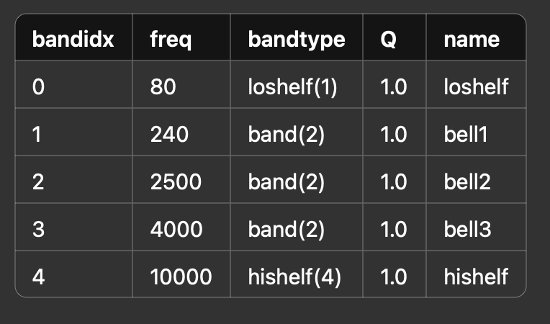
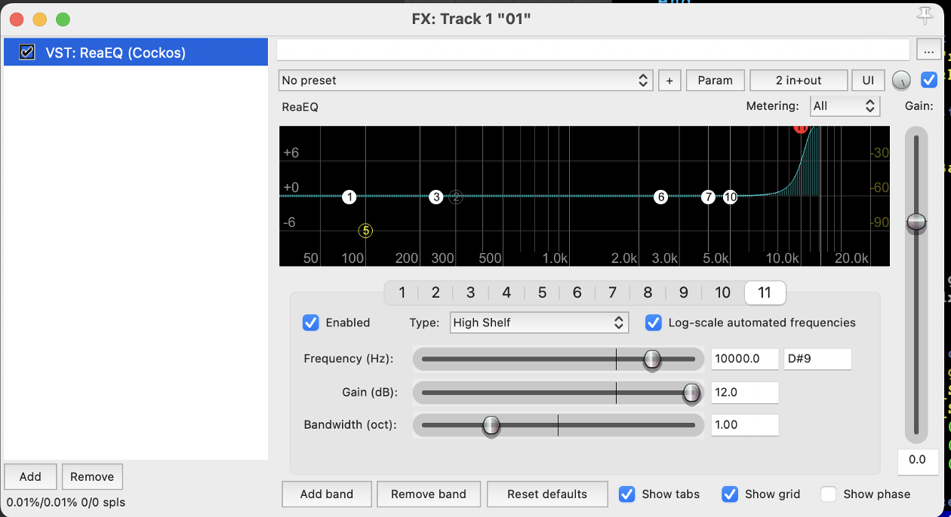
Experiment 1: Single band sweep -12~+12dB (1dB as a unit)

Slide 10
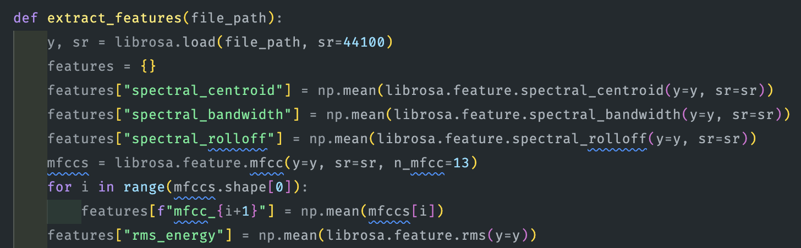
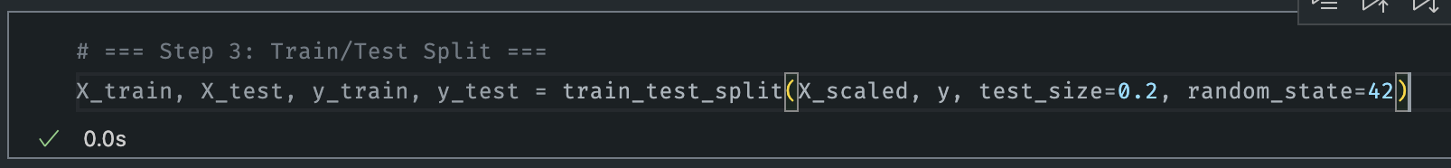

Slide 11
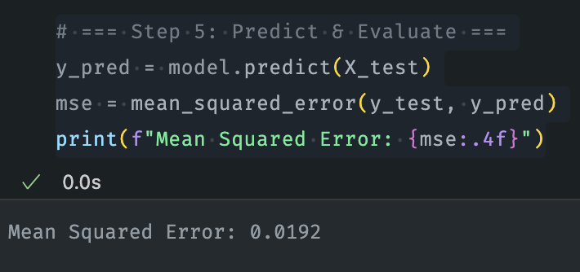
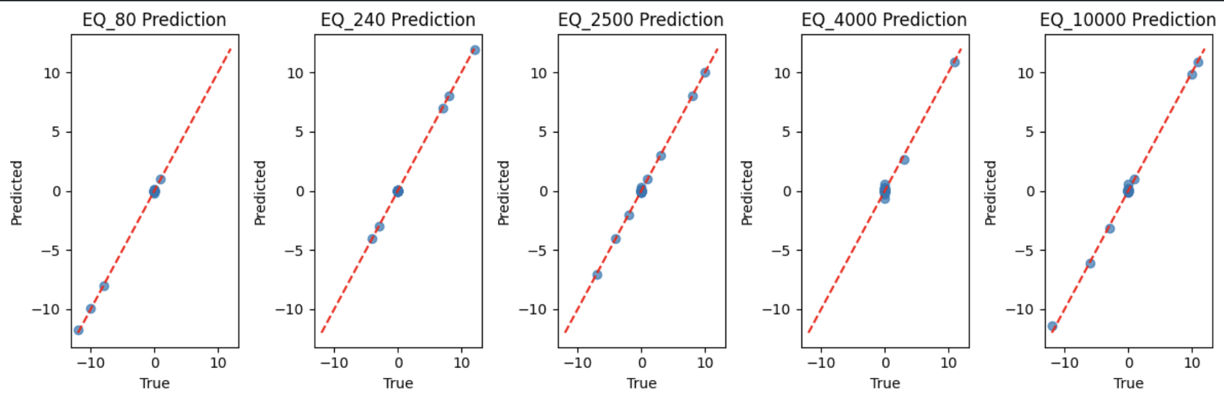
Baseline Model implementation (Regression)

Slide 12
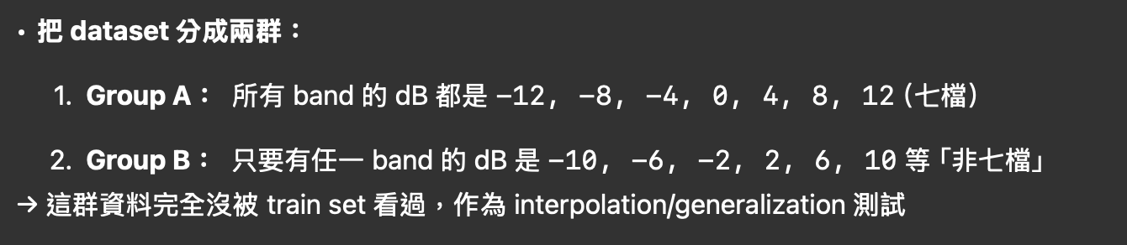
Experiment 2: Interpolation Test
Single band sweep -12~+12dB (4dB as a unit)

Slide 13
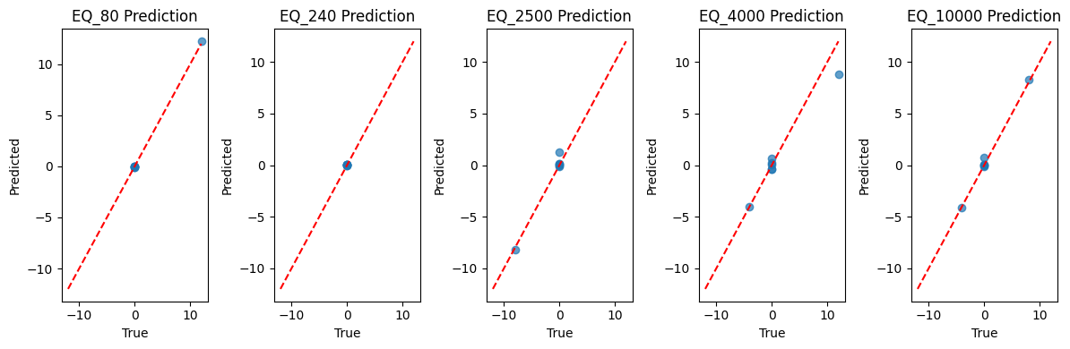
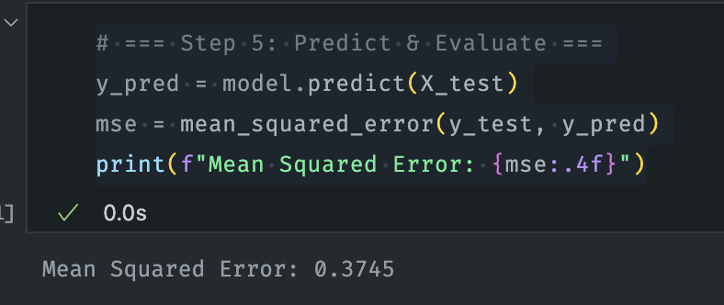
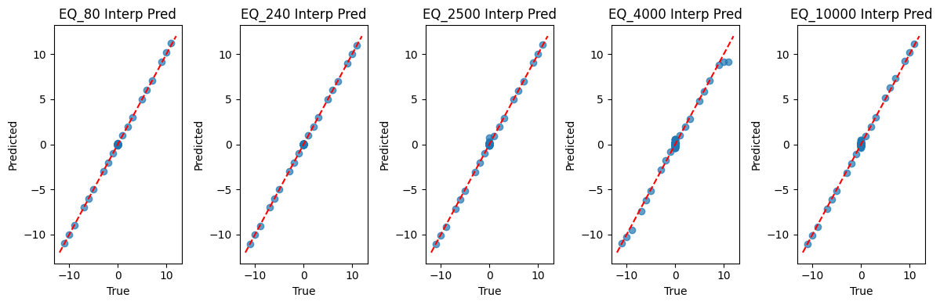
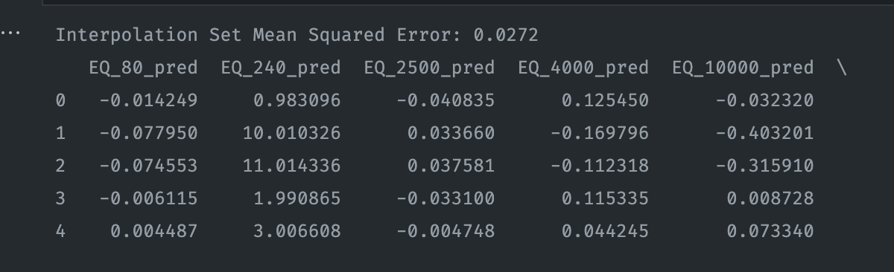
Concludes: We don’t need to actually run this small unit, and also the model learns good not only mapping the answer.

Slide 14
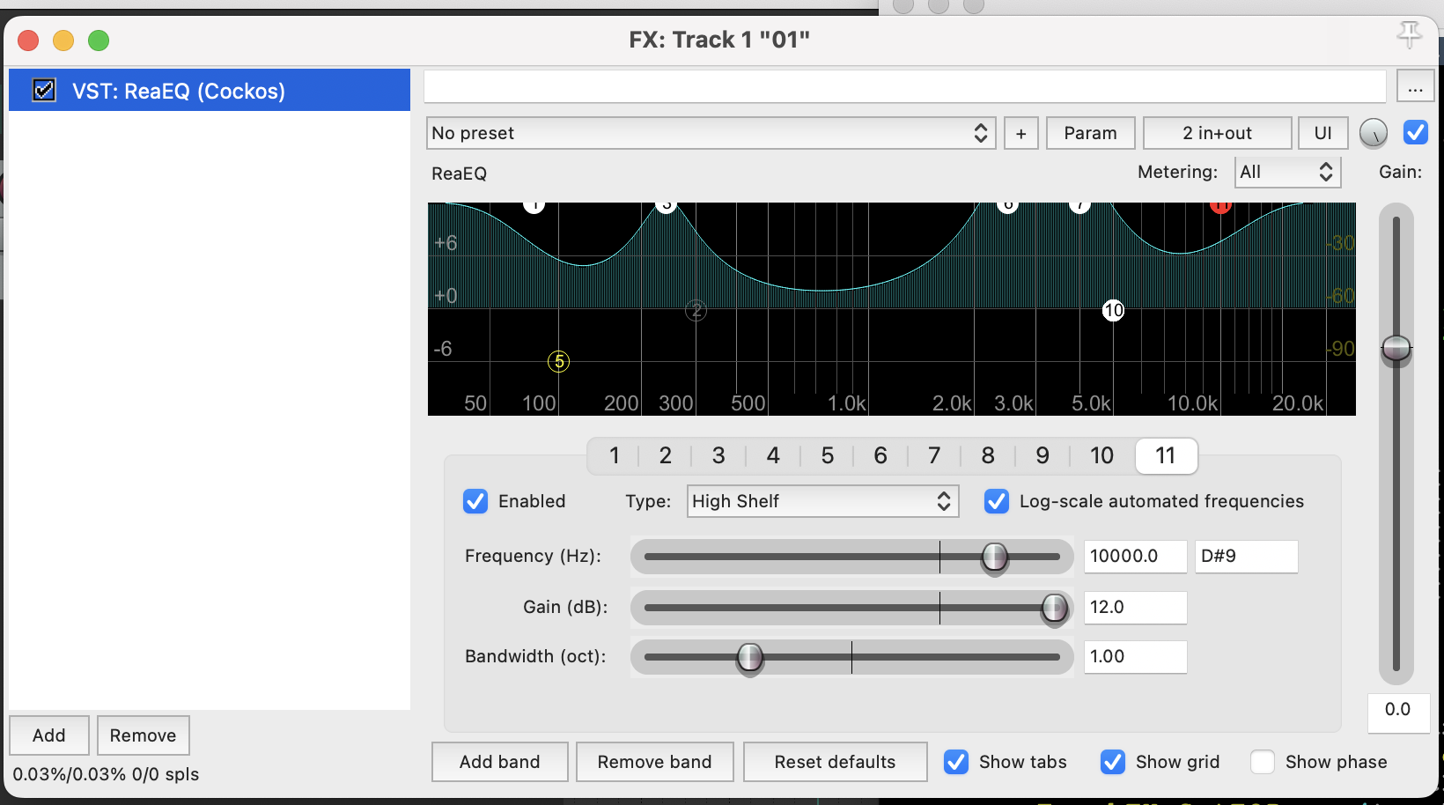
Experiment 3: Multi band sweep -12~+12dB (4dB as a unit)
「多 band sweep」就是同時對五個 band都做七檔 sweep，組合成 7^5 = 16,807 種檔案

Slide 15

V
Thank you!
Now, what’s next?

